Slide 1
Promoting Parental Sportsmanship
Jim Perry
CIF – Southern Section
Athletic Administrator’s Summit
October 17, 2016
Pomona, CA.

Slide 2
Changes In The Game?
“The children now love luxury; they have bad manners and contempt of authority; they show disrespect for their elders and love chatter in place of exercise. Children are now tyrants, not the servants of their households. They no longer rise when elders enter the room. They contradict their parents, chatter before company, gobble their food at the table and
terrorize their teachers.”
Socrates 399 B.C.

Slide 3


Slide 4
Changes In The Game?
BREAKING NEWS . . .
Parents have not changed much either.
Parents have always been crazy.
Parents will away be crazy.
Social media has just exposed the craziness.

Slide 5
Facts: “Coach & Athletic Director Magazine”
Survey of high school coaches nation wide.
60% . . . of coaches say their experiences with parents have worsened over their careers.
29% . . . have issues regarding playing time.

Slide 6
Facts: “Coach & Athletic Director Magazine”
18% . . . have issues regarding helicopter parenting.
17% . . . have issues regarding strategy.

Slide 7
Facts: “Coach & Athletic Director Magazine”
64% . . . of coaches said their athletes have complained about their own parents conduct.
93% . . . of coaches said their school administration had their backs.

Slide 8
Facts: “Coach & Athletic Director Magazine”
89% . . . said boosters had threatened to withdraw funds because of the coach.
79% . . . of coaches have not changed their style over a parent’s complaints.

Slide 9
Facts: “Coach & Athletic Director Magazine”
68% . . . the growth of travel/club/elite teams has made relationships with parents worse.
43% . . . of parents have threatened to transfer their athlete to another school.

Slide 10
Facts: “Coach & Athletic Director Magazine”
32% . . . of coaches blamed the pursuit of scholarships for the rise in problematic parents.
31% . . . of coaches blamed the travel/club/elite team environment.

Slide 11
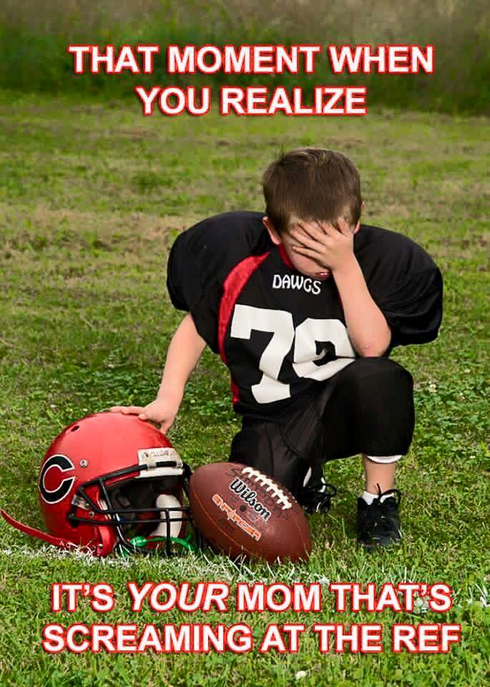

Slide 12
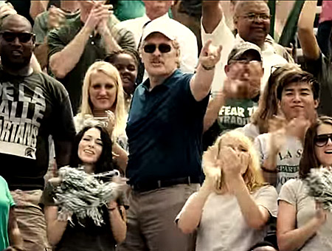

Slide 13
Parental Sportsmanship
Parents send us the best kids they have.
Their most prized possession/s.
Some have outrageous expectations.
“My kid is All Front Yard & All Back Yard.”
“Your kid that can’t play dead in a cowboy movie.”

Slide 14


Slide 15


Slide 16
Parental Sportsmanship
Just assume that parents don’t know how to act.
Here are our school’s expectations for parent behavior . . .
Coaches must lead with proper behavior.
Cheerleaders & cheering sections must lead with proper behavior.

Slide 17


Slide 18
Parental Sportsmanship
Hold everyone accountable
All it takes is one.
Social media . . . “Post”. . . “Send All”
College scholarships are being given out today.
The reality vs. the perception.

Slide 19
Parental Sportsmanship
School site administration all in and on board
Start the message early and often
Feeder schools & feeder programs
Back-To-School Night
Spring Open House
New Students / 8th Grade Nights
Every Booster Club and often
PTA meetings

Slide 20
Parental Sportsmanship
Freshmen Orientation
Cheerleader education
ASB students and their advisor/s
All student-athletes in every sport
Attendance at other events on campus
Classy
Respectful
Well educated

Slide 21
Parental Sportsmanship
“Parent Complaint Protocol” – signed and in the Athletic Clearance packet step by step in writing.
  Head Coach / lower level – Varsity
  Athletic Director
  Assistant Principal in charge of Athletics
  Principal
  District Athletic Director
  Assistant Superintendent

Slide 22


Slide 23


Slide 24
Posted at Every Athletic Venue
Welcome to our school. Sportsmanship is the expectation for everyone.
Let the players . . . Play
Let the coaches . . . Coach
Let the officials . . . Officiate
Parents . . . be a Positive Role Model for our student-athletes.
If you can’t comply, please go home.

Slide 25
Final Thought for Parents
“We assume that any spectator, parent or guest criticizing our officials, umpires or judges is therefore volunteering and willing to officiate, umpire or judge our next athletic contest. This assumption is based on your proven and demonstrated knowledge of all NFHS and CIF contest and game rules and regulations. Thank you in advance for your respect and support of interscholastic athletics.”
Respectfully . . . The All American H.S.

Slide 26


Slide 27
THANK YOU
Jim Perry
District Athletic Director
Huntington Beach Union High School District
5832 Bolsa Avenue
Huntington Beach, CA. 92649 USA
E-mail: JPerry@hbuhsd.edu
Phone: 714-904-7689
Twitter: @PerryJamesLusc

